Slide 1
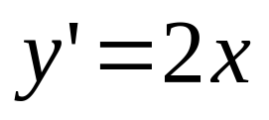
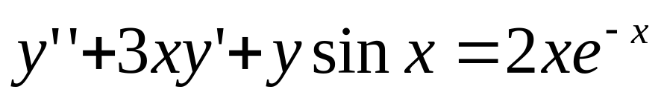
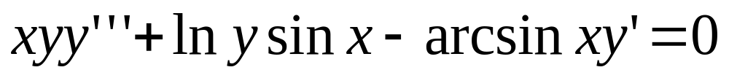
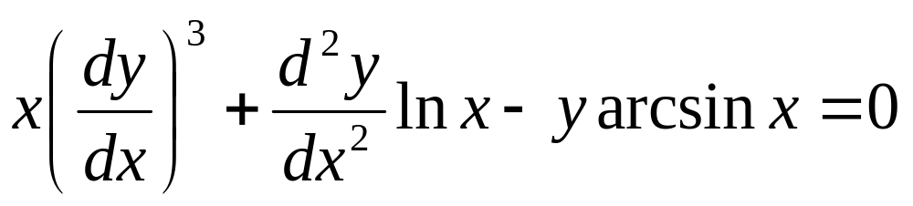
9.1 Definition and Solutions of
Differential Equatios
Definition: The eqution involving the derivatives of an
unknown functin is called the differential eqution.
For example,

Slide 2
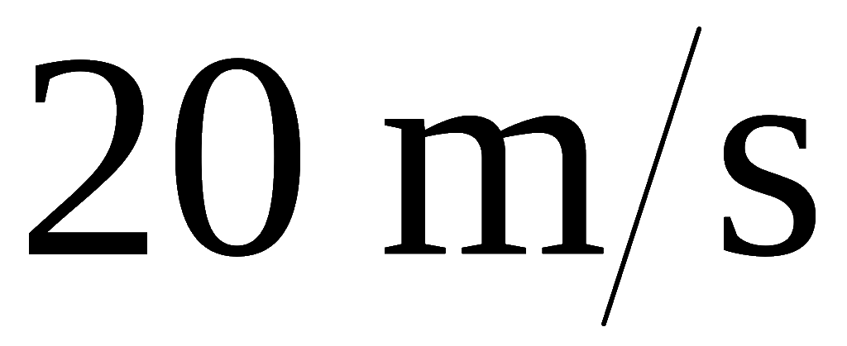
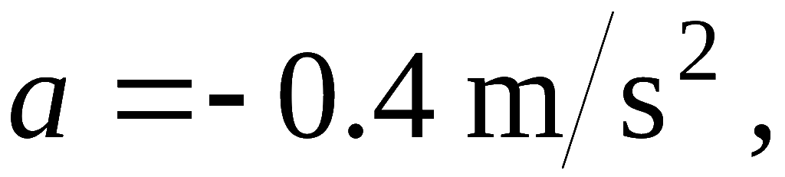
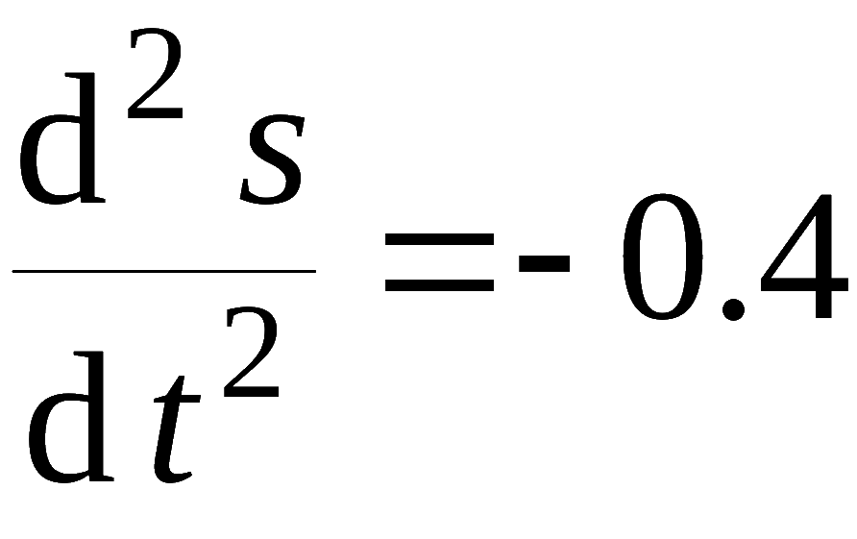
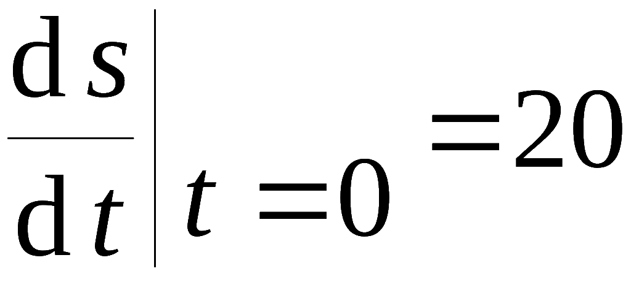

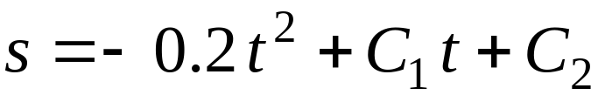
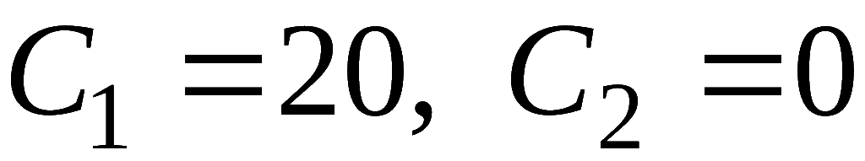
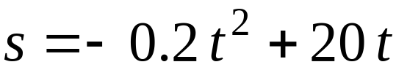
Example:
The car is moving at the velocity of
on a strainght road, it begins to slow down
find the moved distance
of the car after t seconds.
with the acceleration
Solution: Let s be the moved distance of the car after t seconds ,
then we know
and we want to find s = s (t) .
From te first equation, we find
From the second condition, we can determine that
then

Slide 3
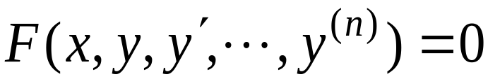
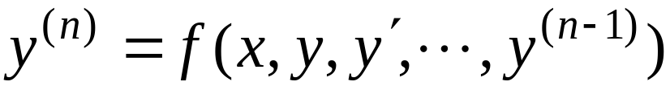
Definition: The order of the highest order derivative is called the order of the differential equation.
Generally , n-th order differential equation is in the form
or
( n-th order explicit differential eqution)

Slide 4
1st-order
2nd-order
3rd-order
2nd-order

Slide 5
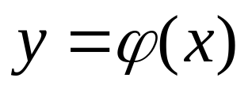
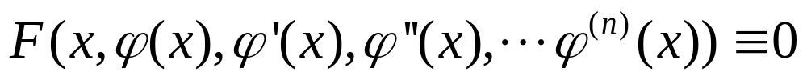
Definition:
1. A solution of a differential equation is a differentiable function defined on an interval I such that
for every x in I
2. If y= φ(x) is a solution of a n-order differental equation, ant it contains n independent arbitrary constants, then y= φ(x) is called a general solution of differential equation. If y= φ(x)
contains no arbitrary constant, it is called a particular solution.

Slide 6
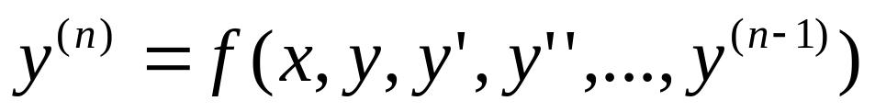
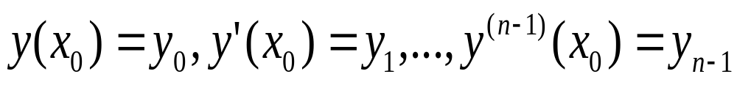
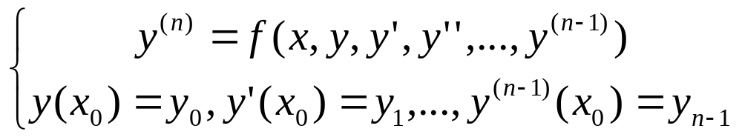
3. Find the solution of the differental equation
satisfying the following initial values:
is called an initial value problem, and we denote it by

Slide 7


Note: The general solution doesn't contain all the solution,
for example
y'(y‒x)=0
the general solution is y=C, and y=x is one particular solution,
but y=x is not in the form y=C
or

Slide 8
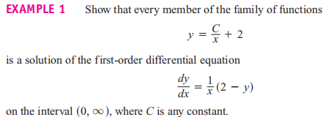
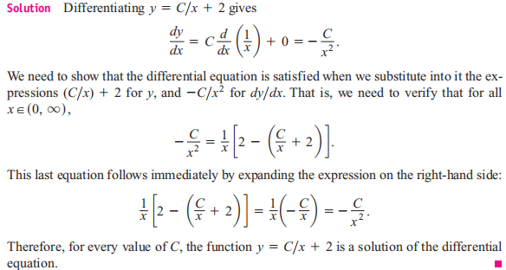

Slide 9
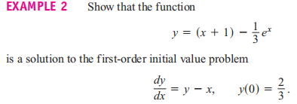

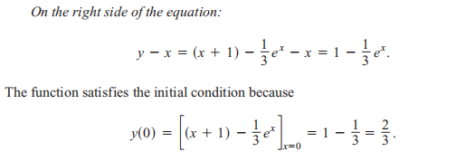
Solution:

Slide 10
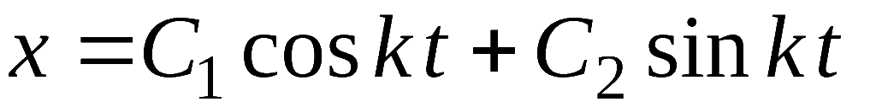

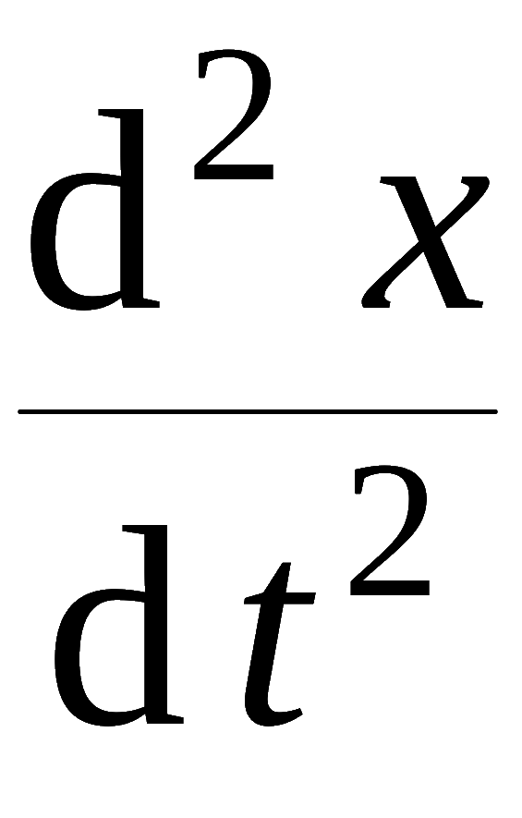
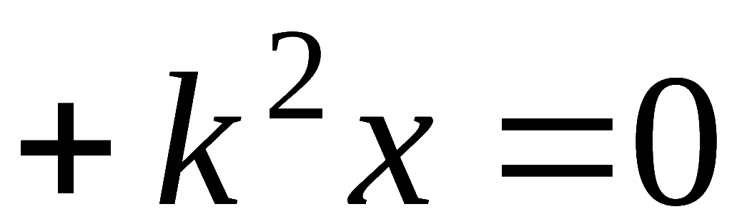
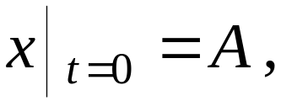
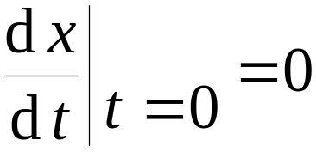
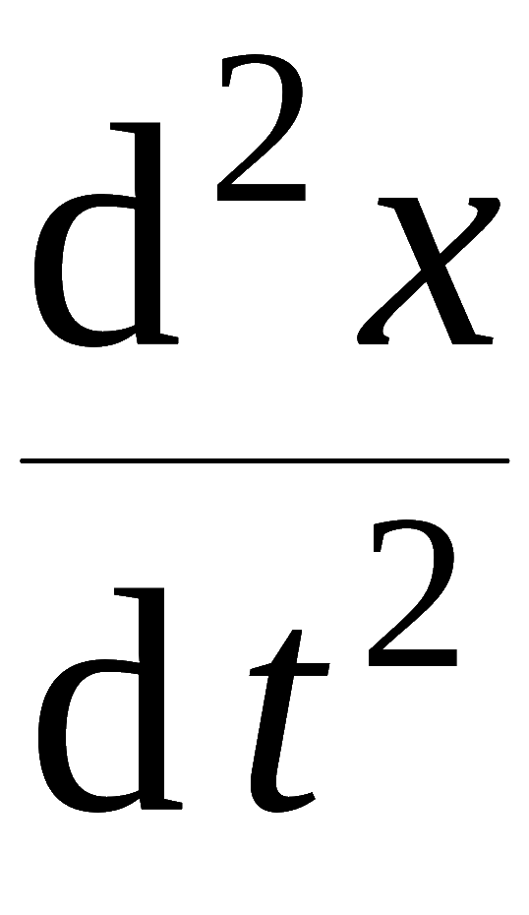
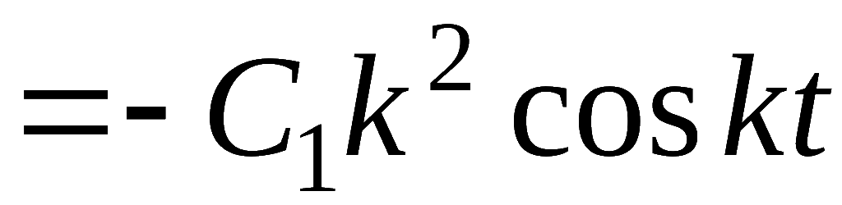
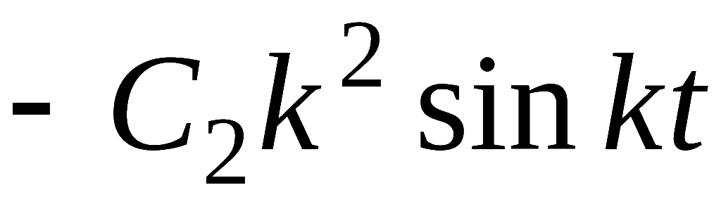
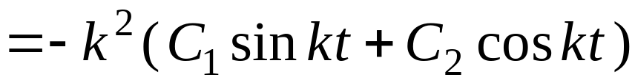
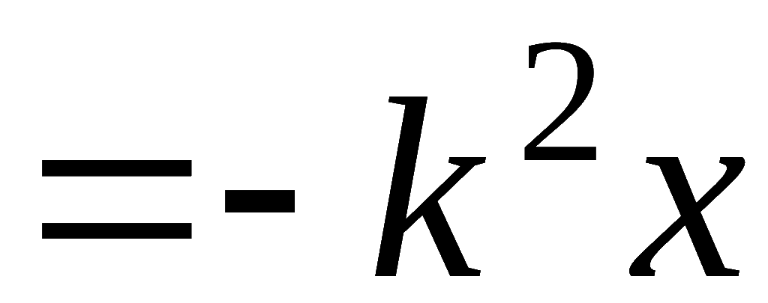

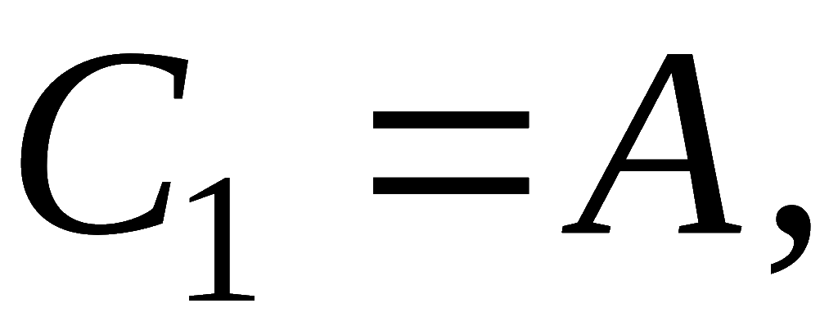
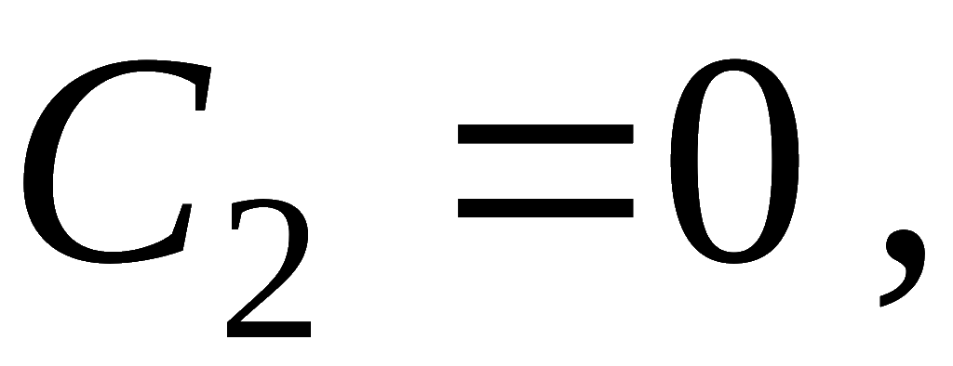

Example 3:
Show that
is the general solution of
, and find the
particular solution satisfying
Solution: Since
which indicates that
is the general solution .
From the initial condition:
then the particular solution is

